Slide 1



FEAST
One stop solution
for Hungry College Students
Group B9

Slide 2
AGENDA
01.
02.
03.
Problem
Vision
Who are we?
04.
05.
06.
Business Model
Product
Solution
07.
Competitors
08.
Launch Strategy

Slide 3

OUR VISION
Provide customers with a single-platform restaurant aggregation system with a calorie tracker

Slide 4





OUR TEAM
Ryan King
CMU Graduate Student
Shreya
Analyst (3 years)
Ruifang Hu
CMU grad student
Alan Chin
CMU grad student
Candice Chiang
Product Manager (3 years)

Slide 5



PROBLEM
Current Solution
Cost
Customer Pain Point
Browsing different platforms to find information
High information cost
Lack of comparison system across platforms
Hard to trace Calorie intake
Browse several apps and sites, or limit their choice
Contact the restaurant or ask people for their views
Record manually or through some app
Customers overpaying
Unable to find desired location/food/etc.

Slide 6
SOLUTION
Impact on your customer
Articulate value proposition
Eliminate the information gap with a single platform
Filtered suggestions to meet users’ expectations
Emphasize the importance of calorie tracking
Update google database
Recommend a platform to save money and save time for food ordering
Suggest top restaurant for their appointment/ meeting/ dating
Easy and effective way to manage their diet

Slide 7



OUR PRODUCT
Restaurant suggestion system based on the menu, food type, rating, and pricing across different apps
Top results like Highest Rated, Date places, Choose Price Level, Frequently Reviewed
Calorie tracker
Update the database
Notes:
Compare delivery fee/avg. pricing from different apps
Personalized restaurant recommendation (for restaurant name, Food types, avg. rating, Food menu, and other predefined filters)
Predefined filters like Highest Rated, Places to Take a Date, Choose Price Level, Frequently Reviewed
: Record what you eat every day, analyze your diet structure based on the data you input and how much more can you intake.

Slide 8
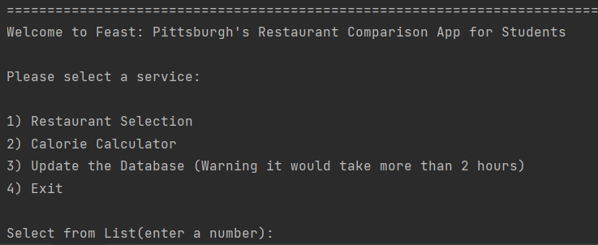
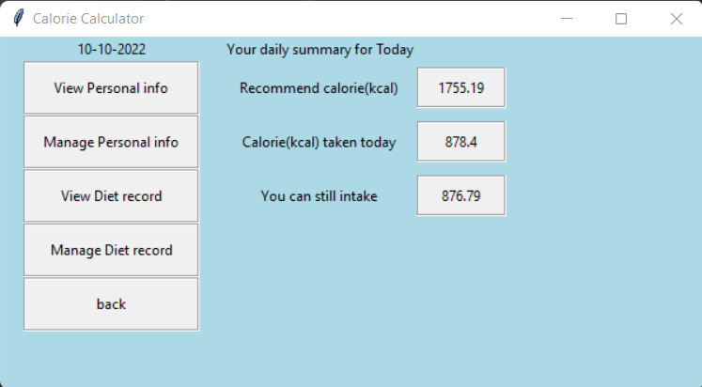
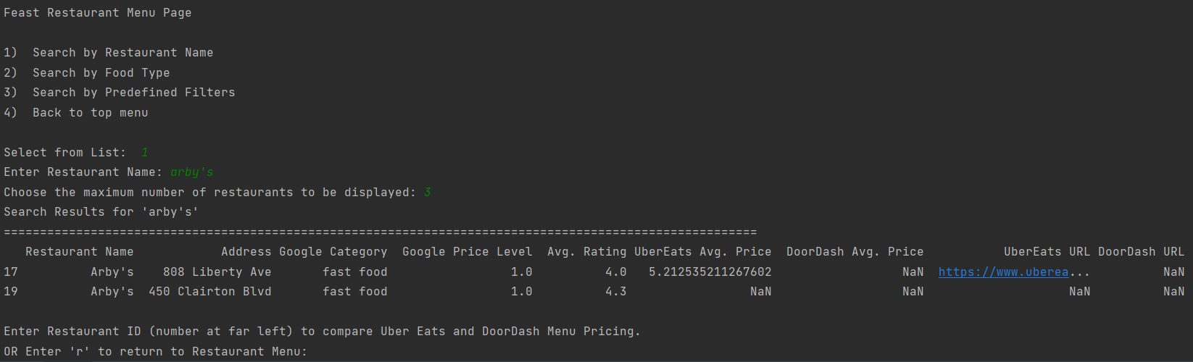
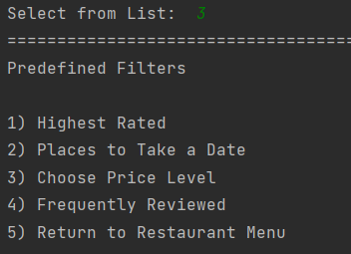
Functionalities

Slide 9
BUSINESS MODEL
How to capitalize?
Pricing details
Metrics
Expand partnerships with more restaurants and small-scale food partners
Partnerships with local Universities
Sales made based on A/B testing of our product benefiting the company
Revenues generated through upselling and cross selling
Number of searches where the restaurants appeared due to our product recommendation

Slide 10
Competitors
Strengths | Yelp | UberEats/DoorDash | Google Search
 | Delivery | Market Leader | Very user friendly
 | Reservation | Widespread use | Ubiquitous
 | Reviews | Name recognition | Wealth of information
One shared weakness:
Lack of side-by-side comparison
Notes:
Relevant findings of SWOT analysis, our competitors possess these strengths, which we will never beat them on.
Our best strategy is to differentiate where they have a weakness, the lack of side-by-side comparison.

Slide 11
What makes us different?
Relevant information presented in one place
Side-by-side menu price comparison
Search and filter features
Special interaction functions - calorie calculator & tracker
Notes:
Feast is unique because it brings together all of the information that those searching for a restaurant want to know, like reviews, price level, and rating, from the three sources they are most likely to look in
Feast allows not only basic comparison metrics across the three platforms, but side-by-side price comparison at the menu price level so you are always sure you’re getting the best deal for the food you want

Slide 12
LAUNCH STRATEGY
Market Strategies
Hold events near colleges (ex. Weekend markets)
Utilize social media to target college students in Pittsburgh
Partner with University Student Orientation Department
Key Performance Indicators and milestones
Number of searches
Review and ratings of the restaurant
Accurate amount of information

Slide 13

FUTURE EXPANSION
Partner with Small scale restaurants to update their menu details
Gather Calorie information on individual items from restaurants
Introduce an application version for our recommendation system

Slide 14

Thank you

